Slide 1
Welcome and Introduction
Kari Nejak-Bowen
University of Pittsburgh School of Medicine
Department of Pathology
April 24, 2018

Slide 2
What is Pathology?
Pathology is the study and diagnosis of disease processes.

Slide 3
Pathology incorporates a wide range of disciplines
Genetics
Micro-biology
Oncology
Molecular Biology
Bio-informatics
Bio-chemistry
Pathology
Anatomy
Compu tational Biology
Surgery
Cell
Biology
Histology
Epi-demiology

Slide 4
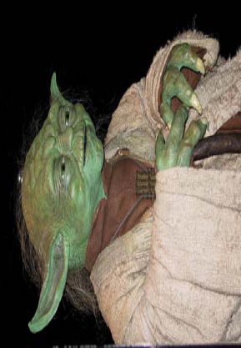
Biology
Pathology
Health
Order
Symbiosis
Homeostasis
Growth
Disease
Disorder
Parasitism
Imbalance
Cancer
Courtesy of Stanley Cohen and Martha Furie

Slide 5
Experimental Pathology…
A scientific field which investigates the type of injury and the body’s response to it by studying:
Causes
Processes
Development
Outcomes and consequences

Slide 6
Experimental Pathologists ask:
What causes disease?
How do we know who is at risk for disease?
How do we diagnose disease?
How do we understand the nature of the disease?
How do we use our understanding of the disease to develop treatments?

Slide 7
How do pathologists study disease?
Pathology can be studied at the organism, organ, cell, or molecular level
Cell and tissue responses to injury include:
Injury/inflammation
Repair/adaptation
Neoplasia/cancer
redzuannorazlan.blogspot.com

Slide 8
How do pathologists study disease?
Experimental pathologists often use cells grown in the laboratory to study the initiation and progression of disease
Animal models are also used in order to study the effect of a disease on the entire body

Slide 9
Misconceptions about animal research
Research on animals isn’t necessary
We have to understand basic biology to learn how to treat/cure disease.
Animals are used along with computer models, cell cultures and human studies.
Treatments developed in animals don’t work on people
Knowledge attained through laboratory animal research has played a vital role in almost every major medical advance of the last century, including organ transplants, analgesics, antibiotics, anti-depressants, bypass surgery, heart catheterization, joint replacement, and more.

Slide 10
Misconceptions about animal research
Research is animal abuse
Most research is not painful.
If an animal is in pain, pain medication must be given.
If an animal is suffering, it will be removed from the study or euthanized.
Researchers don’t care about animals
Research is highly regulated, and researchers are committed to animal welfare.
An Animal Care and Use Committee at each institution rigorously reviews all proposed studies.
Veterinarians help design protocols.
Animals get care from skilled technicians and veterinarians.

Slide 11
Animal research is essential for pathologists to understand disease and develop cures
http://www.understandinganimalresearch.org.uk/

Slide 12
Why teach pathology in high school?
The “three R’s”
Relevant
Our understanding of disease is becoming more advanced
Health care is also becoming more complex
There is a wealth of misleading information on health and disease topics
It is estimated that nearly 9 out of 10 adults may lack the skills needed to manage their health and prevent disease
https://health.gov/communication/literacy/quickguide/factsbasic.htm

Slide 13
Why teach pathology in high school? (continued)
Real-world application of science
Many students have been affected by disease in their daily lives
Rewarding and interesting
Knowing more about their own health and bodies can empower students

Slide 14
What pathology-related topics are high school students interested in learning more about?
Most Interested
Least Interested
AIDS
Cancer*
Genetic testing
Stem cells*
Biological warfare
Allergies
Arthritis
Asthma
Tobacco
Obesity
Special thanks to Jaime Bhalla and Martha Furie

Slide 15
How to find information on pathology-related topics?
The internet is a great resource for both teachers and students
Much of pathology is visual
Pictures and examples will catch the attention of students
A great self-learning tool, where students can progress at their own pace
Opportunity for independent investigation

Slide 16
How to evaluate online health information
When visiting a new health web site, these questions may help you decide whether it is a helpful resource:
Who runs the site?
Why have they created the site?
What do they want from you?
What is the source of the information?
Who is paying for the site?
Is the information reviewed by experts?
Is it up-to-date, and is it reviewed?
Does the site make unbelievable claims; does it sound too good to be true?
Are original sources of the data and research listed?
https://nccih.nih.gov/health/webresources
https://medlineplus.gov/webeval/webeval.html

Slide 17
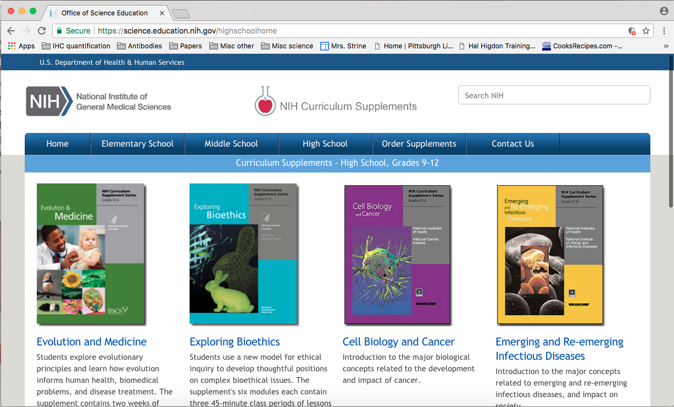
Science resources for teachers: NIH Curriculum Supplements
https://science.education.nih.gov/highschoolhome

Slide 18
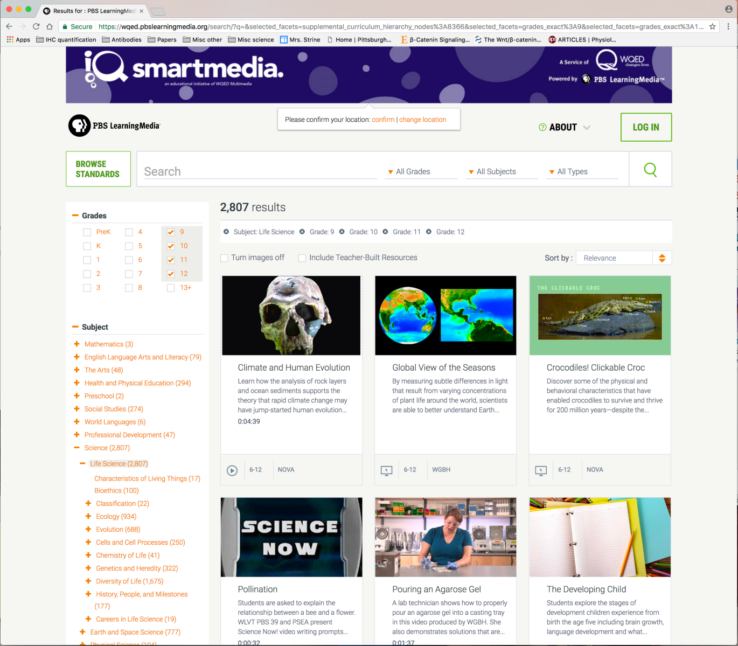
Science resources for teachers: PBS Classroom Resources
https://wqed.pbslearningmedia.org/

Slide 19
Science resources for teachers: Howard Hughes Medical Institute
http://www.hhmi.org/biointeractive

Slide 20
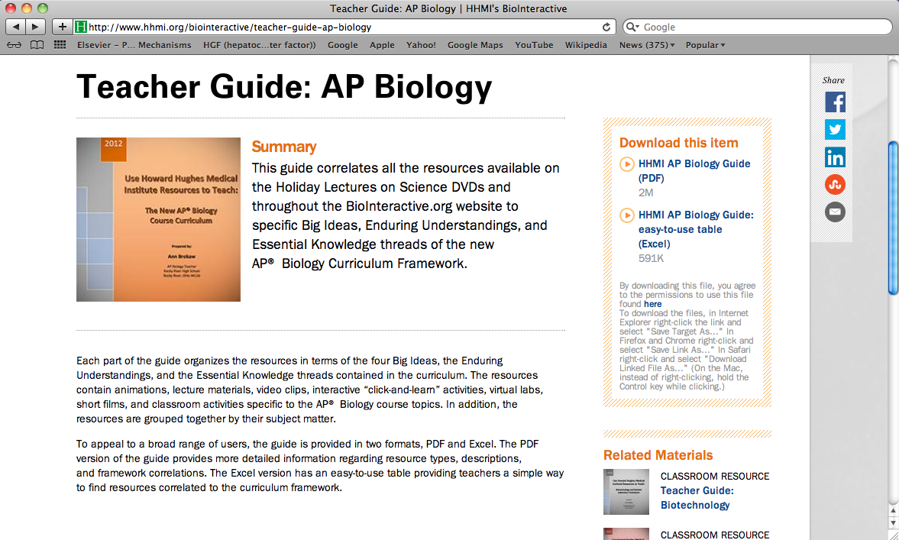
HHMI’s Biointeractive resources include Teacher Guides for many topics in biology

Slide 21
What about resources for students interested in pathology?
2 ways to find information about pathology:
Internet search engines
Health and patient education web sites
There are also “interactive” websites that allow the user to browse images and content, as well as case-based approaches to learning pathology concepts.
Other websites offer advice on careers in pathology.

Slide 22
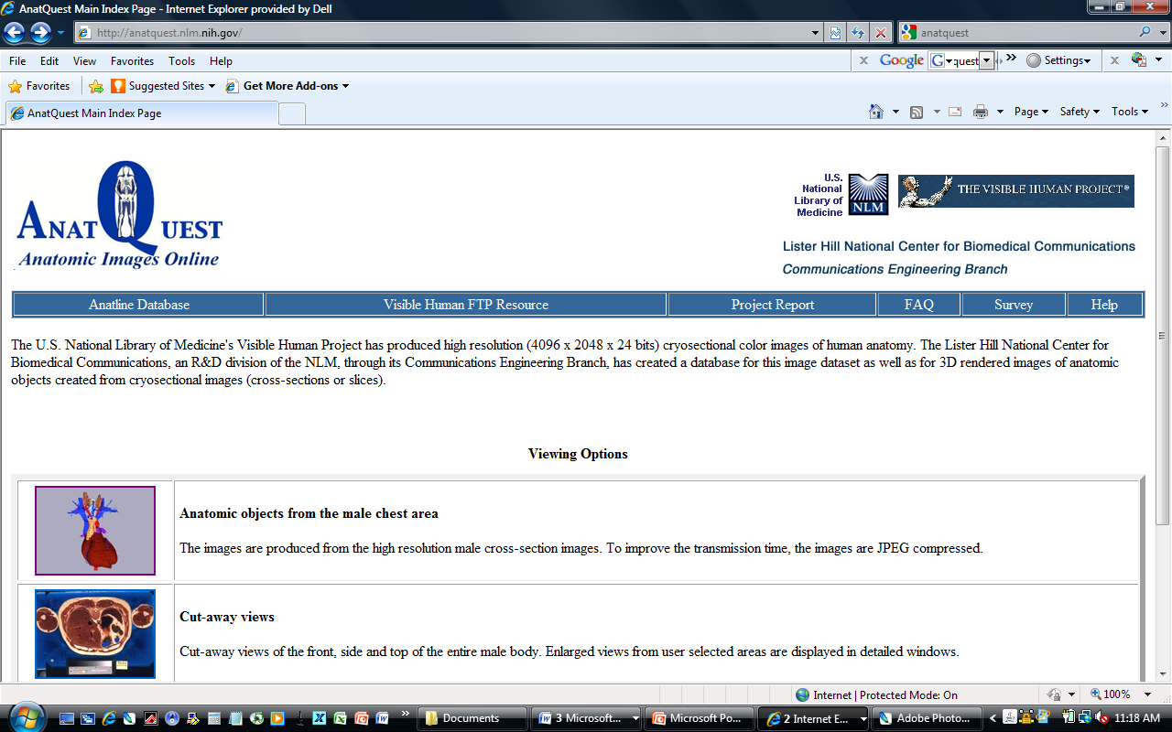
Anatquest, an NIH-sponsored site for anatomic images
http://anatquest.nlm.nih.gov/

Slide 23
Webpath, a website containing images and descriptions of diseases & pathologic conditions
http://library.med.utah.edu/WebPath/webpath.html

Slide 24
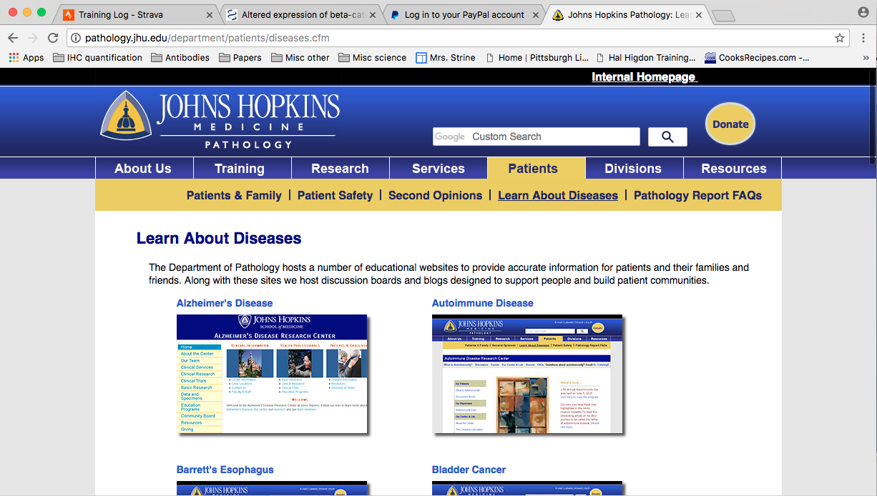
Johns Hopkins’ Department of Pathology also provides information on diseases
http://pathology.jhu.edu/department/patients/diseases.cfm

Slide 25
The University of New South Wales has an online “museum of human diseases”
http://medicalsciences.med.unsw.edu.au/community/museum-human-disease/home

Slide 26
WebPathology is a collection of surgical pathology images
http://www.webpathology.com/

Slide 27
Pathologic Basis of Disease Interactive Case Study Companion contains images with associated question/answers
http://web.squ.edu.om/med-Lib/MED_CD/E_CDs/Pathologic%20Basis%20of%20Disease/indextoc.html

Slide 28
Medpix, a database of radiology teaching files and images
https://medpix.nlm.nih.gov/home

Slide 29
Visible Proofs (history of forensic medicine website)
http://www.nlm.nih.gov/visibleproofs/index.html

Slide 30
The Pathology Guy (general topics on pathology as well as forensic issues)
http://www.pathguy.com/

Slide 31
The Interactive Pathology website contains summaries, images, and microscopy of 100 different diseases and conditions
http://peir.path.uab.edu/wiki/IPLab

Slide 32
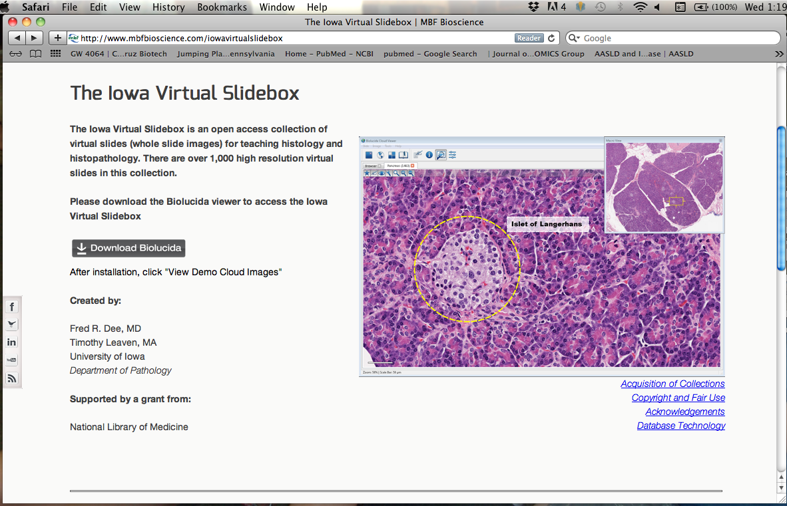
The Virtual Slidebox shows images of tissues microscopically
http://www.mbfbioscience.com/iowavirtualslidebox

Slide 33
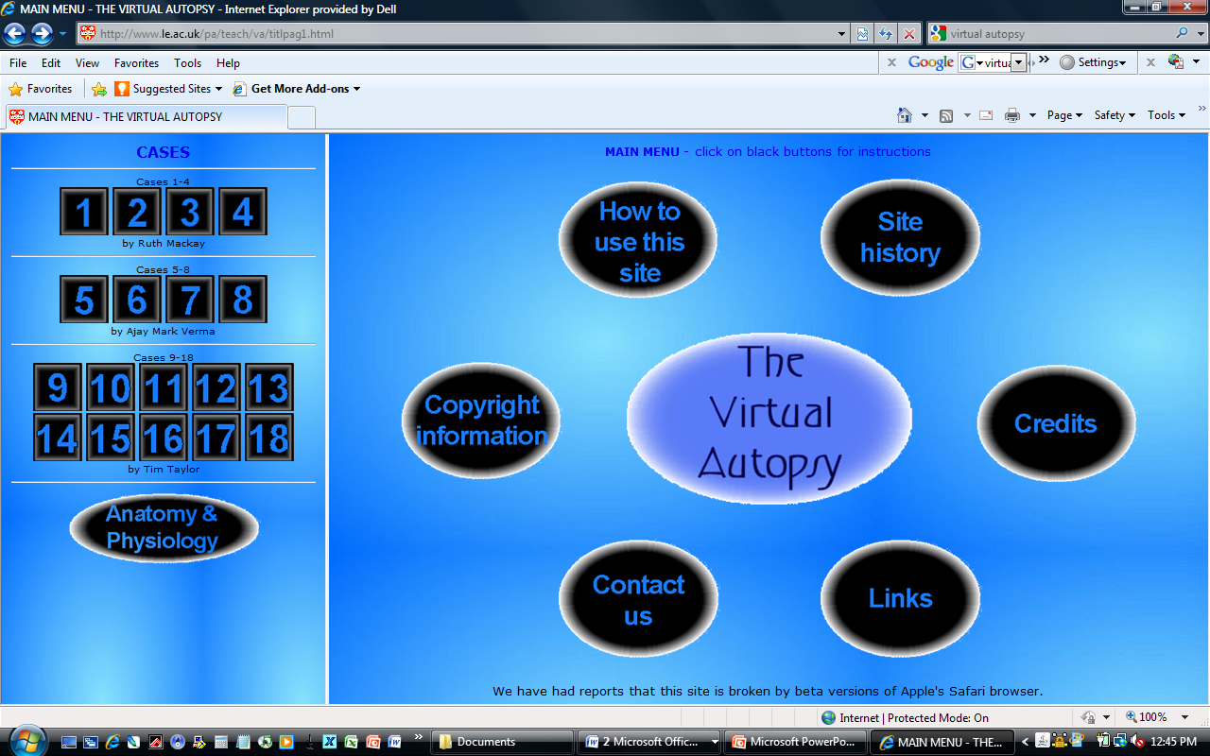
Virtual Autopsy is an interactive experience that allows students to diagnose cases
http://www.le.ac.uk/pa/teach/va/welcome.html

Slide 34
How do I know if a career in biology is right for me?
http://www.mynextmove.org/explore/ip

Slide 35
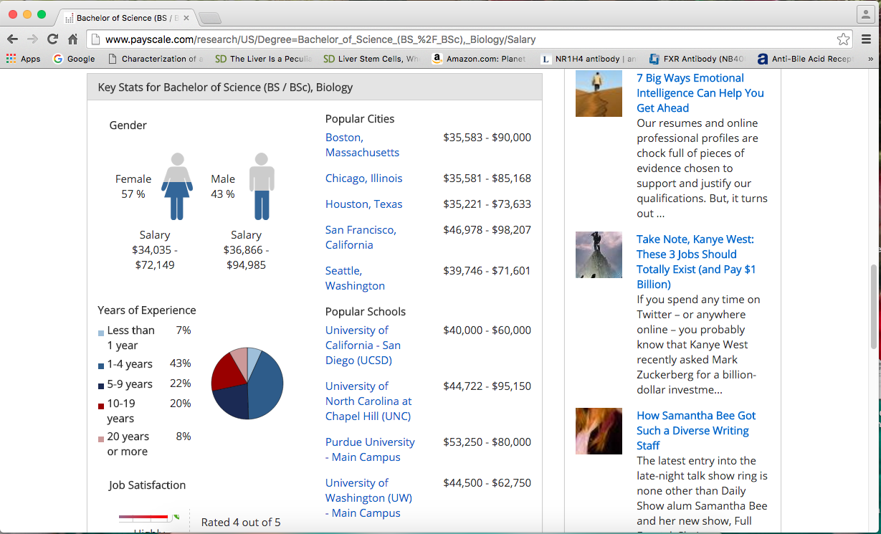
Payscale.com will help you find out the average salary for biology majors
http://www.payscale.com/research/US/Degree=Bachelor_of_Science_(BS_%2F_BSc),_Biology/Salary

Slide 36
Science Buddies has more information about careers in biology, and a page devoted specifically to pathology
http://www.sciencebuddies.org/science-engineering-careers#lifesciences

Slide 37
ASIP’s Pathology: A Career in Medicine page also contains a helpful introduction to pathology, including subspecialties and case studies
http://www.pathologytraining.org/Career/index.cfm

